Slide 1

A Unified Communication System to Bridge the Gap for Inclusive Interaction among Individuals with and without Hearing and Speaking Abilities
TEAM MEMBERS:
Nandhini S
Pavithra S
Rithikaezhil N
GUIDE: Dr. S. Anitha Elavarasi

Slide 2
BACKGROUND AND MOTIVATION
High prevalence of hearing impairments, especially in countries like India.
Communication barriers between individuals with hearing impairments and those without.
Limited understanding and proficiency in sign language among the general population.
Importance of promoting inclusivity and accessibility for individuals with hearing impairments.

Slide 3
PROBLEM STATEMENT
Communication barriers exist between those with and without hearing and speaking abilities, limiting interaction.
To develop a real-time system using Computer Vision, Machine Learning to accurately interpret hand gestures
Enable seamless communication through speech conversion.
Utilize CNN for accurate gesture recognition and pyttsx for translating sign languages into spoken languages.

Slide 4
LITERATURE REVIEW
AUTHOR, PAPER TITLE & JOURNAL NAME, YEAR | APPROACH | FINDINGS
Yin, Aoxiong, et al. "Mlslt: Towards multilingual sign language translation." Proceedings of the IEEE/CVF Conference on Computer Vision and Pattern Recognition. 2022. | CNN for continuous sign recognition on ISLR and CSLR dataset | Many Cardinality for single sign from continuous sign language recognition with very good accuracy
Dushyant Kumar Singh, “3D-CNN based Dynamic Gesture Recognition for Indian Sign Language Modeling”, 5th International Conference on AI in Computational Linguistics, 2021 | 3D Convolutional Neural Network | 20 ISL words,accuracy-88%, helps in reducing problems faced while communicating with deaf and dumb people. Drawback: Model trained for only 20 words, absence of speech generation, low accuracy

Slide 5
LITERATURE REVIEW
AUTHOR, PAPER TITLE & JOURNAL NAME, YEAR | APPROACH | FINDINGS
Suardi, Citra, et al. "Design of Sign Language Recognition Using E-CNN." 2021 3rd East Indonesia Conference on Computer and Information Technology (EIConCIT). IEEE, 2021. | CNN with filtering and deep learning | CNN resolves visual recognition problems with higher accuracy and ensemble methods, deep learning were employed
Rachana Patil1, Vivek Patil1, Abhishek Bahuguna1, and Mr. Gaurav Datkhile1, “Indian sign language recognition using convolutional neural network”, ITM Web of Conferences, 2021 | Computer Vision techniques such as gray-scale, dilation and mask operation, CNN | ISL dataset(1-10 digits), accuracy-95%, used for effective human machine interaction Drawback: Dataset consists of only digits and the model is trained only for recognizing digits.

Slide 6
LITERATURE REVIEW
AUTHOR, PAPER TITLE & JOURNAL NAME, YEAR | APPROACH | FINDINGS
Kadhim, Rasha Amer, and Muntadher Khamees. "A Real-Time American Sign Language Recognition System using Convolutional Neural Network for Real Datasets." Tem Journal 9, no. 3 (2020). | CNN for spatial feature extraction | Efficient feature extraction from video frames on ASL dataset
Mehreen Hurroo, Mohammad Elham Walizad, “Sign Language Recognition System using Convolutional Neural Network and Computer Vision”, International Journal of Engineering Research & Technology (IJERT), dec-2020 | Uses CNN of 3 layers with ReLu, 2D CNN with tensor flow library | ASL Dataset with 10 alphabets, accuracy-90%, used in real-time for sign language recognition Drawback: Model is trained only for 10 alphabets.

Slide 7
LITERATURE REVIEW
AUTHOR, PAPER TITLE & JOURNAL NAME, YEAR | APPROACH | FINDINGS
Amrita Thakur, Pujan Budhathoki, Sarmila Upreti, Shirish Shrestha, Subarna Shakya, “Real time sign language recognition and speech generation”, Journal of innovative image processing, 2020 | CNN, VGG-16 model | ASL dataset,accuracy-94.65%,can be used as learning tool for beginners Drawback: Lack of generating basic words
Sonkusare, Jayesh S., Nilkanth B. Chopade, Ravindra Sor, and Sunil L. Tade. "A review on hand gesture recognition system." In 2015 International Conference on Computing Communication Control and Automation. IEEE, 2015. | Camshift for tracking, MRS-CRF for recognition | Features compared to Shift algorithm, Efficient for dynamic gesture recognition on self generated dataset Drawback: CNN give 90.45% accuracy when compared to CRF which gives only 85.3%

Slide 8
LITERATURE REVIEW
AUTHOR, PAPER TITLE & JOURNAL NAME, YEAR | APPROACH | FINDINGS
Fayed F. M. Ghaleb, Ebrahim A. Youness, Mahmoud Elmezain, Fatma Sh. Dewdar, “Vision-Based Hand Gesture Spotting and Recognition Using CRF and SVM”, Journal of Software Engineering and Applications, 2015 | Human Computer Interaction, Conditional Random Fields, Support Vector Machine | Digits Dataset(0-9), accuracy- 92.50% Drawback: Trained for only recognizing digits
Shirbhate, Radha S., Vedant D. Shinde, Sanam A. Metkari, Pooja U. Borkar, and Mayuri A. Khandge. "Sign language recognition using machine learning algorithm." International Research Journal of Engineering and Technology (IRJET) 7 | SVM for classification, HMM for temporal sequence | SVM for Optimal hyperplane separation, HMM for temporal analysis on ISLR dataset Drawbacks: Limited performance in complex sign language gesture

Slide 9
RESEARCH GAPS
Existing sign language recognition systems for ASL primarily focus on identifying single alphabetical characters or digits, with only a few recognizing all 26 alphabets.
These systems lack speech generation capabilities for Regional Sign Language and often target users familiar with sign language.
Accuracy and data scarcity are key disadvantages of existing systems.

Slide 10
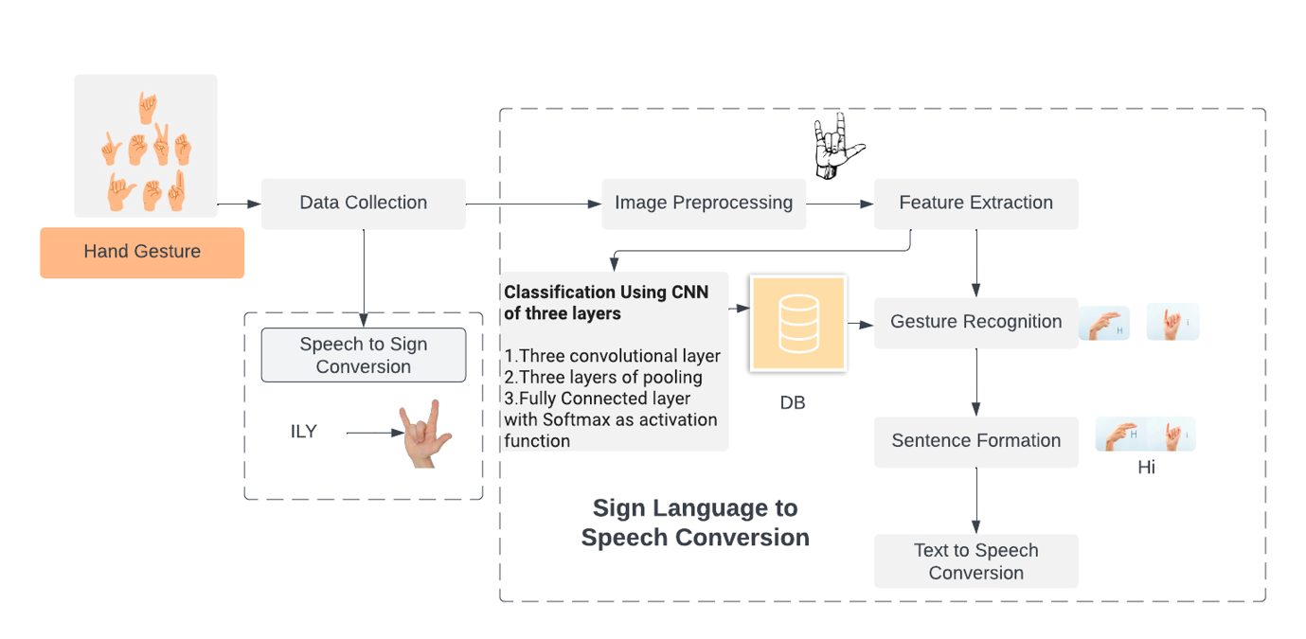
ARCHITECTURE

Slide 11
PROPOSED SYSTEM - MODULES
Data Collection
Gesture Recognition
Communication
OpenCV
CNN
pyttsx3
1
2
3
1. Data Collection
1. Data Preprocessing
2. Training
3. Gesture Recognition
4. Voice Generation

Slide 12
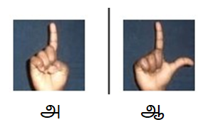
1. DATA COLLECTION
Global alphabets, regional language letters, phrases, and sentences
Utilized a comprehensive global dataset for word and phrase recognition analysis
Each word represented by multiple scenes shot from various angles and lighting conditions to enhance model robustness.

Slide 13

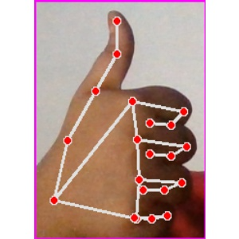
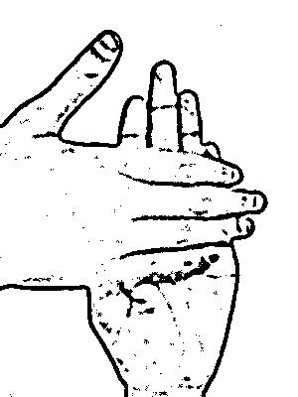
2. DATA PREPROCESSING
Input image will further used to extract hand gesture features.
MediaPipe Hand detection is used for finger point detection
Thresholding separates hand region from background.
Raw Image
After applying finger point detection

Slide 14
3. TRAINING
CNN-based model utilized for Sign Language Interpretation system.
Architecture includes three convolutional layers with ReLU activation, followed by max pooling, flatten, and fully connected layers with SoftMax activation.
Adam optimizer employed to enhance accuracy and reduce loss.
Trained for 15 epochs, achieving 94% accuracy.

Slide 15
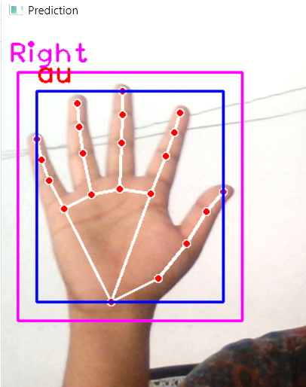
4. GESTURE RECOGNITION
Real-time hand gesture captured using OpenCV.
Captured image pre-processed and loaded into the trained CNN-based model.
Model predicts hand gesture class.
Display of predicted hand gesture name.

Slide 16
5. SPEECH GENRATION
Text-to-speech feature added to enhance communication for hearing-impaired and visually impaired individuals.
Implementation utilizes Python libraries - pyttsx3
Playsound - for playing audio of recognized text.

Slide 17
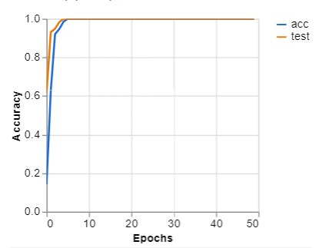
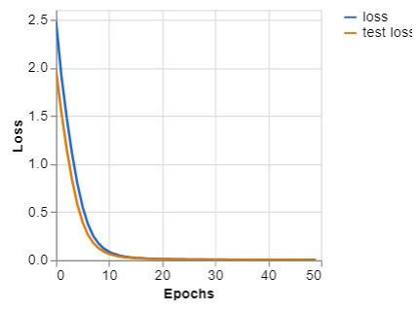
RESULT AND DISCUSSION
CNN model trained for 15 epochs achieved a 94% accuracy rate.
The accuracy assessment is based on the current training progress.
This milestone indicates significant progress toward achieving accurate sign language recognition.

Slide 18
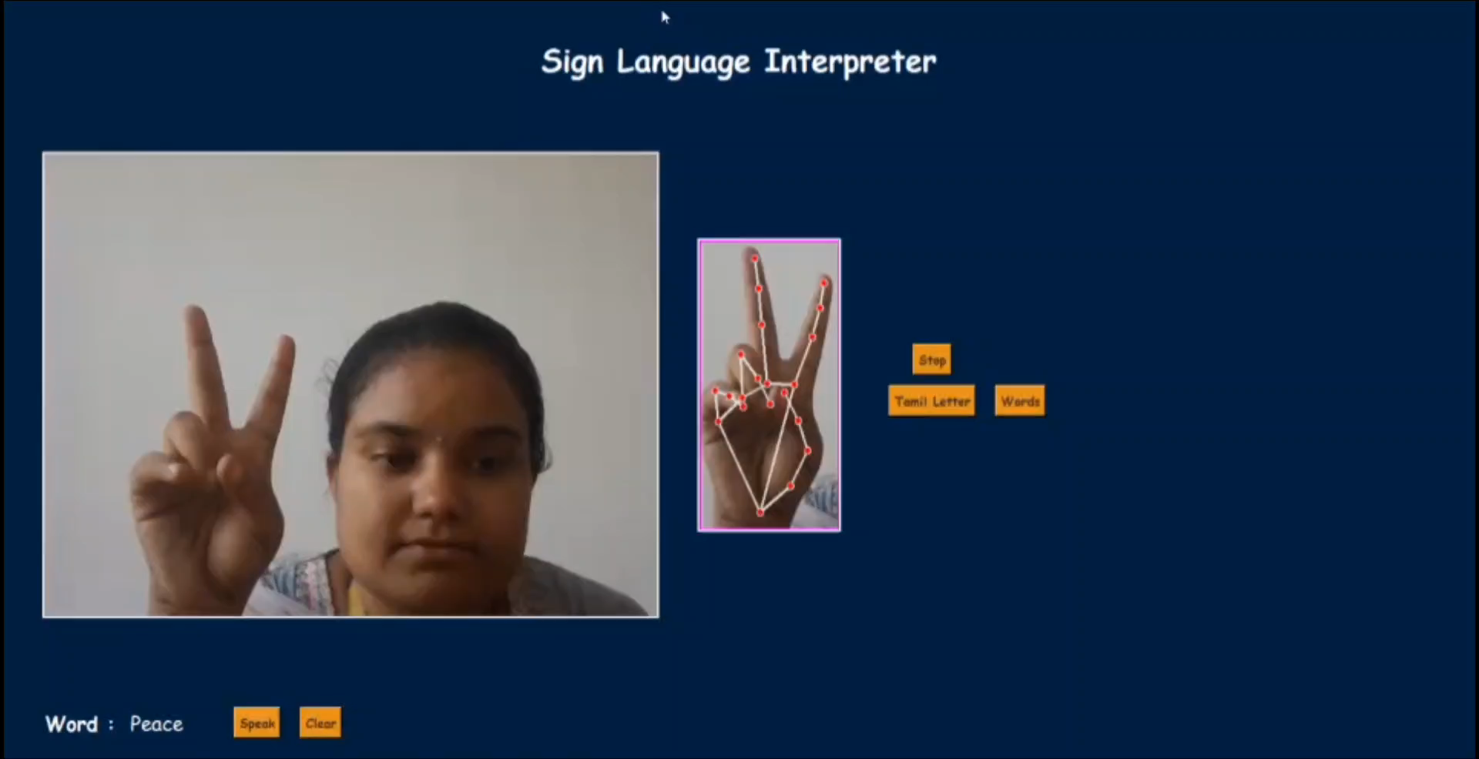
RESULT AND DISCUSSION

Slide 19
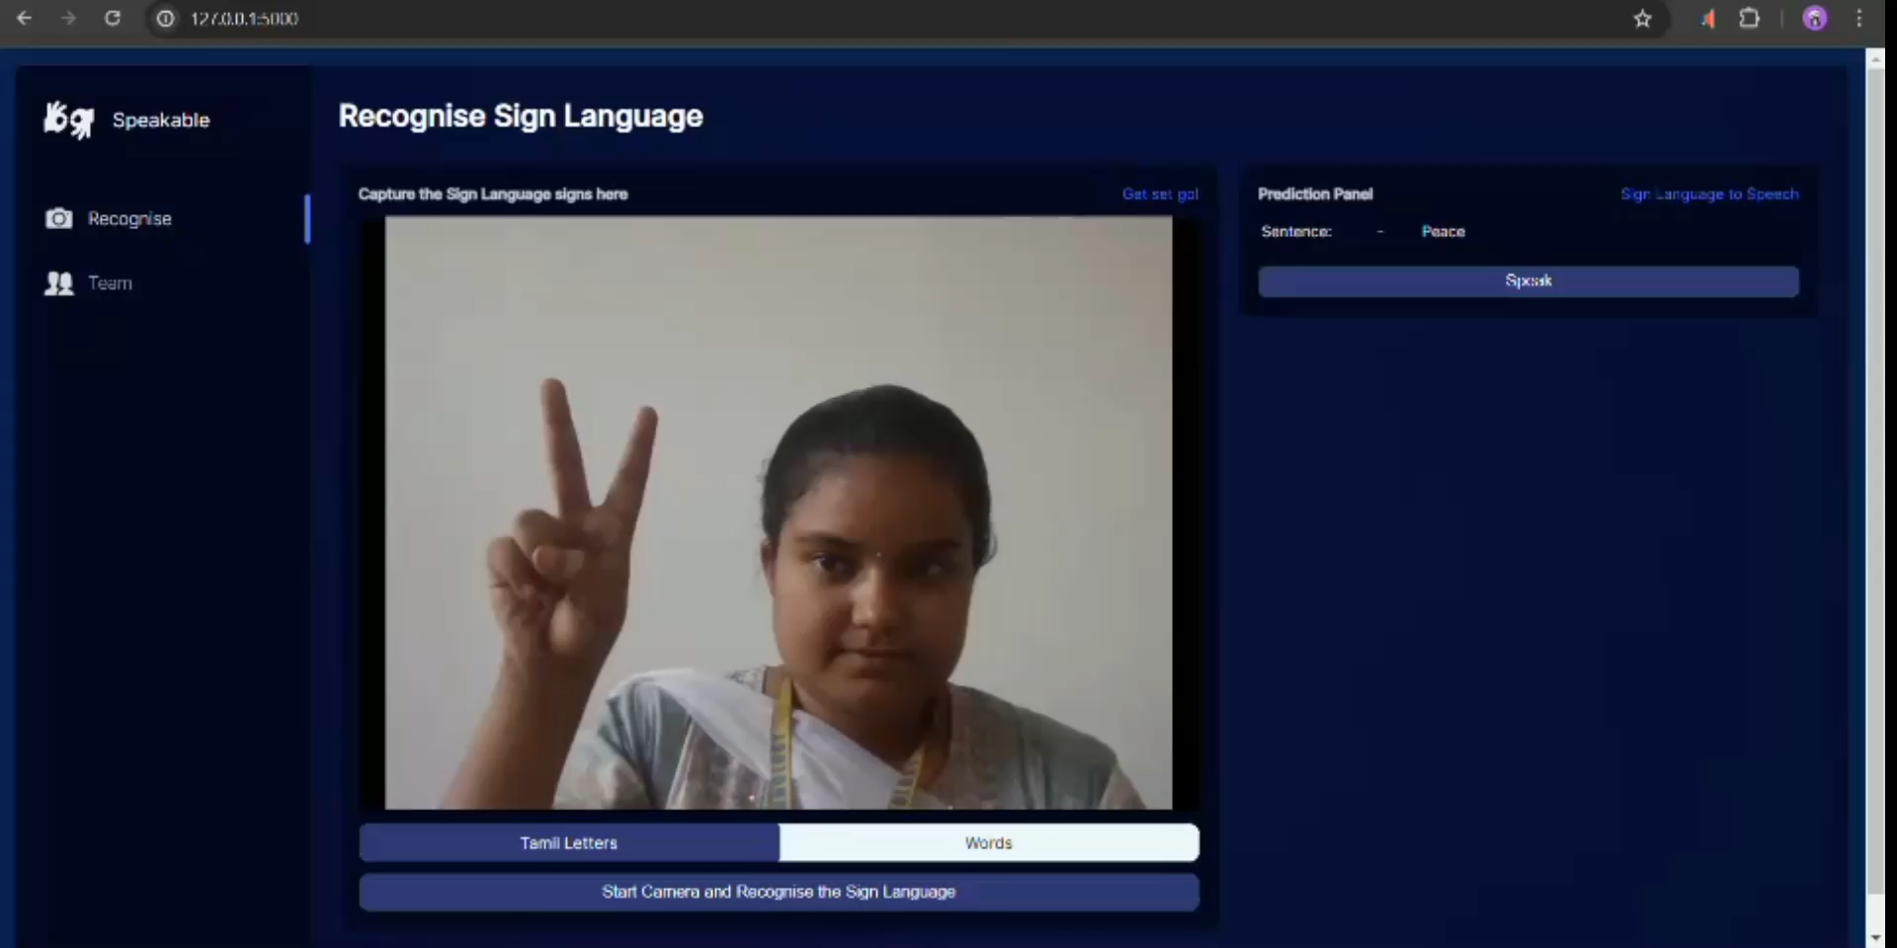
RESULT AND DISCUSSION

Slide 20
CONCLUSION AND FUTURE WORK
Achieved 94% accuracy in recognizing Uyir, Mei, Ayutha Eluthukal, English alphabets, and digits.
Strong foundation for improved communication accessibility.
Future plans include expanding language support to include Regional sign language.
Integration of everyday phrases for broader inclusivity.

Slide 21
REFERENCES
[1] Jayesh S Sonkusare, Nilkanth B Chopade, Ravindra Sor, Sunil L Trade "A review on hand gesture recognition system" 2015. International conference on computing communication control and Automation.
[2] Prof Radha S Shirbate, Mr Vedant D Shinde, Ms Sanam A Metkari, Ms Pooja U Borkar, Ms Mayuri A Khangde, "Sign Language Recognition using machine learning algorithm"(2020).
[3] Raksha Amer Kadhim and Mentadher kameer "A real-time american sign language recognition system using convolutional neural network for real datasets"TEM joprnal 9(3):937,2020.
[4] Sai Bharat Pandigala, Gogineni Hrushikesh, Mahav, Saranu Kishore kumar,"Video based sign language recognition using CNN-LSTM", Published on IRJET (2022).
[5] Jiao, P., Min, Y., Li, Y., Wang, X., Lei, L., & Chen, X. (2023). CoSign: Exploring Co-occurrence Signals in Skeleton-based Continuous Sign Language Recognition. In Proceedings of the IEEE/CVF International Conference on Computer Vision (pp. 20676-20686).
[6] Kaur, J., & Krishna, C. R. (2019). An efficient Indian sign language recognition system using sift descriptor. International Journal of Engineering and Advanced Technology, 8(6), 1456-1461.
[7] Suardi, C., Handayani, A. N., Asmara, R. A., Wibawa, A. P., Hayati, L. N., & Azis, H. (2021, April). Design of Sign Language Recognition Using E-CNN. In 2021 3rd East Indonesia Conference on Computer and Information Technology (EIConCIT) (pp. 166-170). IEEE.
[8] Kaur, J., & Krishna, C. R. (2019). An efficient Indian sign language recognition system using sift descriptor. International Journal of Engineering and Advanced Technology, 8(6), 1456-1461.
[9] Elavarasi, S. A., Jayanthi, J., & Basker, N. (2019). Trajectory object detection using deep learning algorithms. Int. J. Recent Technol. Eng, 8.
[10] Sridharan, M., Arulanandam, D. C. R., Chinnasamy, R. K., Thimmanna, S., & Dhandapani, S. (2021). Recognition of font and tamil letter in images using deep learning. Applied Computer Science, 17(2).

Slide 22
THANK YOU

